Slide 1
Big Data Processing
Jiaul Paik

Slide 2
Representation Learning on Graph

Slide 3
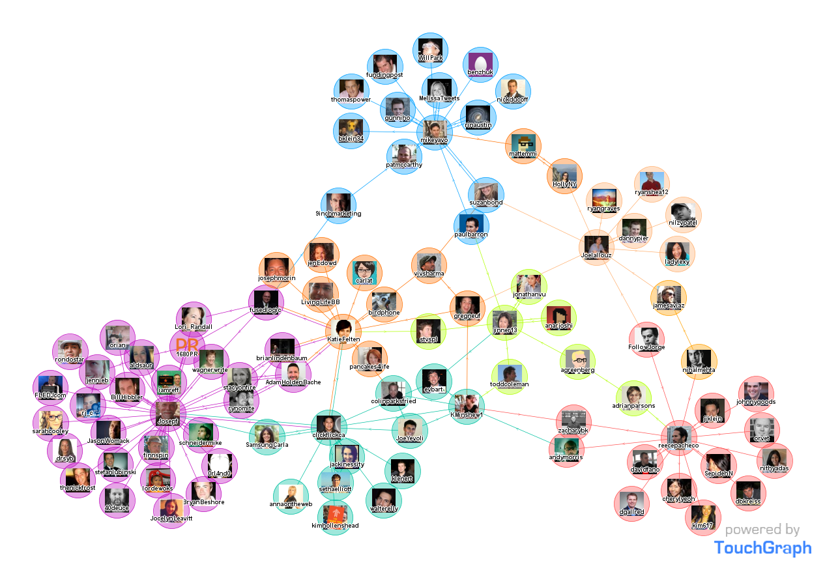
Let us start with a Question
How do you find which nodes are similar?
Source: Google Image Search

Slide 4
Embedding Nodes
Input
Output
Represent each node as d-dimensional vector so that “similar” nodes in the graph have similar vectors
Mining Massive Datasets, Jure Leskovec

Slide 5
Setup
Assume we have a graph G:
V is the vertex set.
A is the adjacency matrix

Slide 6
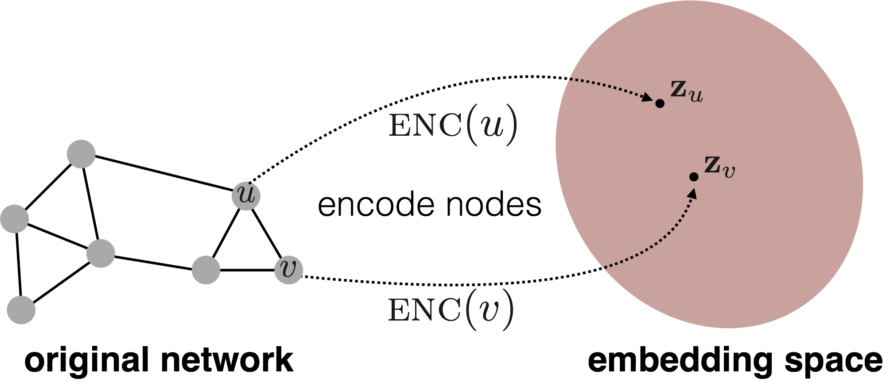

Embedding Nodes
Goal is to encode nodes so that similarity in the embedding space approximates similarity in the original network.

Slide 7
Node Embedding
Goal:
Mining Massive Datasets, Jure Leskovec

Slide 8
Learning Node Embeddings: How?
Define an encoder (i.e., a mapping from nodes to embeddings)
Define a node similarity function (i.e., a measure of similarity in the original network).
Optimize the parameters of the encoder so that:

Slide 9
Two Key Components
Encoder maps each node to a low-dimensional vector.
Similarity function specifies how relationships in vector space map to relationships in the original network.

Slide 10
Approaches to Similarity: Outline
Adjacent Neighbor based similarity
Multi-hop based similarity
Random walk based similarity

Slide 11
Adjacent Neighbour based Similarity

Slide 12
Similarity = the edge weight between u and v in the original network.
Intuition = Dot products between node embeddings approximate edge existence.
Loss function
embedding similarity
(weighted) adjacency matrix for the graph
sum over all node pairs

Slide 13
How to Find the Embedding vectors?
Objective: Find all $Z∈ℝ^{d x |V|}$ such that loss $ℒ$ is minimum
Method: Use stochastic gradient descent (SGD) as a general optimization method.
Highly scalable approach

Slide 14
Drawbacks
O(|V|²) runtime. (Must consider all node pairs.)
Only considers direct, local connections.

Slide 15
Multi-hop Similarity Based Approach

Slide 16
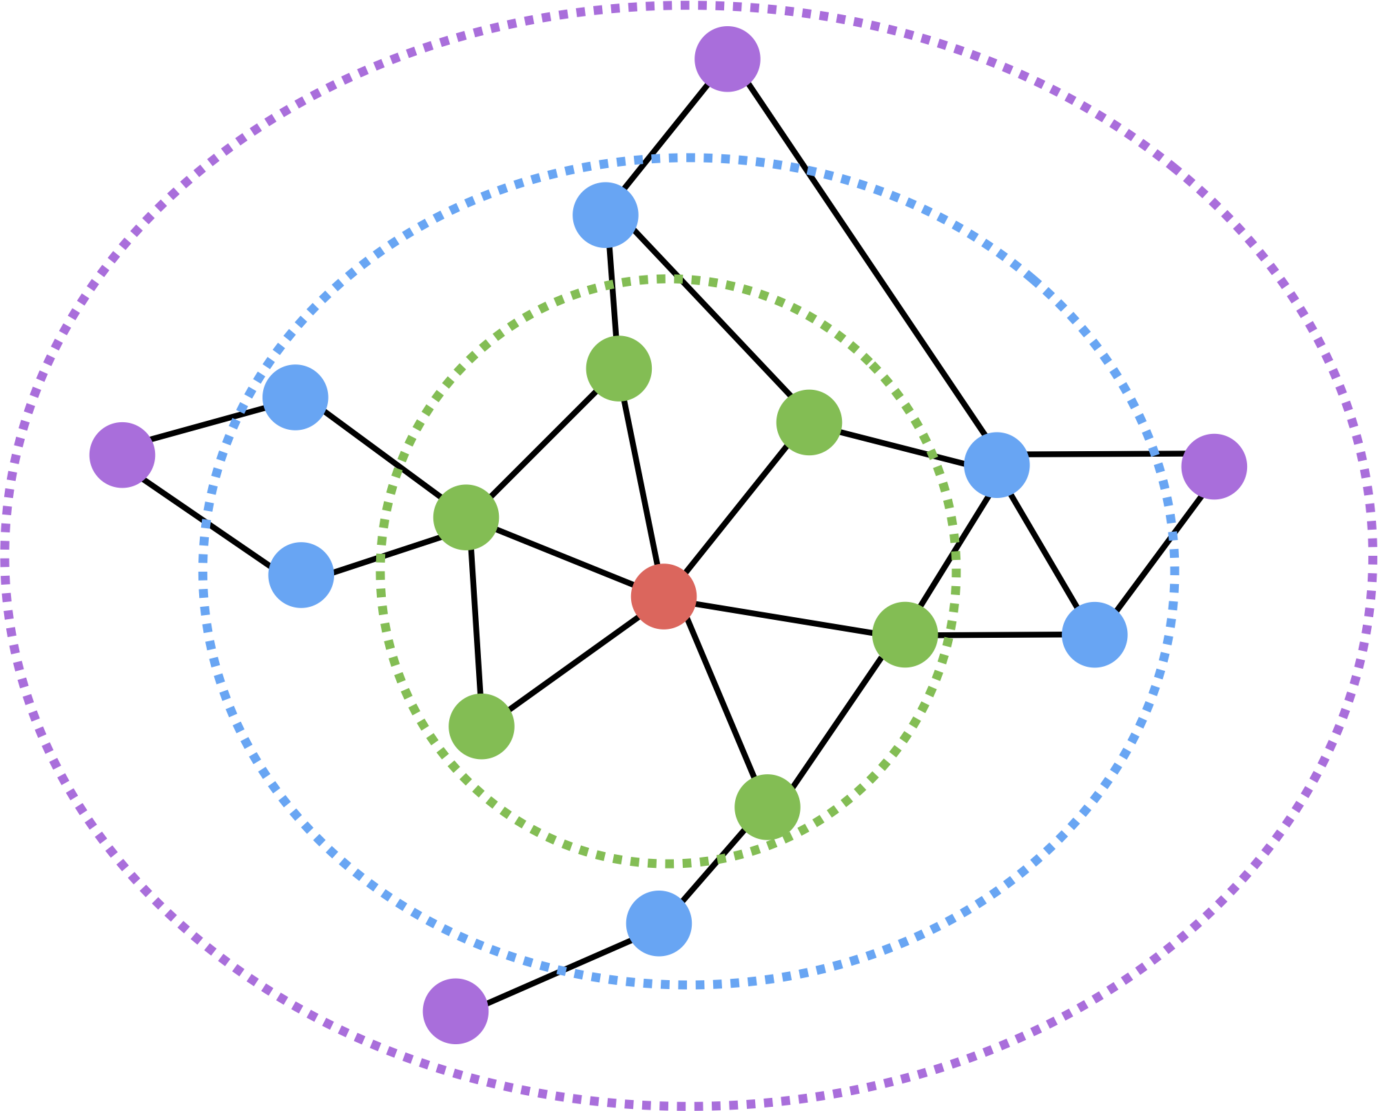
Multi-hop Similarity
Consider k-hop neighbors for each node.
Red: Target node
Green: 1-hop neighbors
Blue: 2-hop neighbors
Purple: 3-hop neighbors

Slide 17
Random Walk Approach

Slide 18
Random-walk Embeddings
probability that u and v co-occur on a random walk over the network

Slide 19
Random-walk Based Embeddings
Estimate probability of visiting node v starting from node u using some strategy R.
Optimize embeddings to encode these random walk statistics.

Slide 20
Why Random Walks?
Efficiency: Do not need to consider all node pairs when training; only need to consider pairs that co-occur on random walks.

Slide 21
Main Steps
Run short random walks starting from each node on the graph using some strategy R.
For each node u collect N_{R}(u): the set of nodes visited on random walks starting from u.
Optimize embeddings according to:

Slide 22
Random Walk Optimization
Intuition: Optimize embeddings to maximize likelihood of random walk co-occurrences.
Parameterize P(v | z_{u}) using softmax:
Objective: Find embeddings z_{u} that minimize L

Slide 23
Random Walk Optimization
This is too expensive!!
Denominator runs over all nodes

Slide 24
Solution
Negative sampling: instead of normalizing w.r.t. all nodes, just normalize against k random “negative samples”
random distribution over all nodes
sigmoid function

Slide 25
Negative Sampling
random distribution over all nodes
Sample negative nodes proportional to degree.
Higher k gives more robust estimates.

Slide 26
Random Walk: Summary
Run short random walks starting from each node on the graph using some strategy
For each node u collect N_{R}(u), the nodes visited on random walks starting from u.
Optimize embeddings according to:
Use negative sampling to optimize!

Slide 27
How should we randomly walk?
Option 1: Just run fixed-length, unbiased random walks starting from each node
Option 2: Perform bias walk without length restriction

Slide 28
Biased Walks: Intuition
Apply biased random walks that can trade off between local and global views of the network
Breadth-first sampling (BFS)
Depth-first sampling (DFS)
Grover and Leskovec, 2016

Slide 29
Example
Two approaches to define neighborhood of a node:
$$N_{BFS}\left(u\right)=\{ s_{1},s_{2},s_{3}\}$$
Local view
$$N_{DFS}\left(u\right)=\{ s_{4},s_{5},s_{6}\}$$
Global view

Slide 30
Biased Walk
$${Prob\left(t=v \right| t−1=u)=α×P}_{ij }$$
$t:$timestamp
$α$: bias parameter
$P_{ij}:$Original transition probability

Slide 31
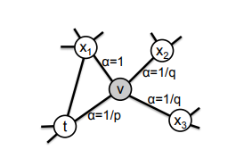
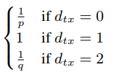
Choosing the bias parameter
Consider a random walk that just traversed edge (t, v) and now resides at node v
$$α=$$
$$d_{tx}=shortest distance from t to x (the node it is considering to visit)$$

